Slide 1


Engaging Online
with Reading & Pre-reading Skills
Dr. Terri Hessler, Associate Professor
The Ohio State University at Newark
Lannette Gandee, Teacher
Par Excellence Academy

Slide 2
Objectives
Participants will
See 5 examples of instructional tasks (aligned with the science of reading) typically in 1-1 or small group instruction
  Phonemic awareness
  Phonics
  Vocabulary
  Fluency
  Comprehension
See how to provide same 5 instructional tasks in an on-line group instruction format with high-quality and highly engaging components

Slide 3
Reading Instruction & SOR
Structured Literacy Approach
The HOW
Explicit Instruction (I-do, We-do, You-do)
Systematic & Cumulative (use scope & sequence; build on each lesson)
Hands on, Engaging, & Multimodal (listen, see, speak, write)
Diagnostic & Responsive (student responses determine pacing, presentation and practice)

Slide 4
Reading Instruction & SOR
Structured Literacy Approach
The WHAT
Phonemic Awareness
Letter-sound correspondence (see-say-hear-write)
Spelling (sounds, syllables)
Patterns and conventions of print (FLOSS, spelling /k/)
Comprehending
  Words (morphology)
  Sentences (syntax and semantics; sentence structure)
  Paragraphs (structure & organization)
  Longer Text (discourse analysis)

Slide 5
Phonemic Awareness
Recognizing the individual sounds in a word
For youngest students
Practice saying words and segmenting the phonemes (sounds)

Slide 6


Slide 7


Slide 8


Slide 9
Alphabetics (Phonics)
Letter-Sound Corresp. – Visual Drill
In OG lesson – Card drill, beginning of lesson
Practice saying sounds, keywords
Practice letter formation when first learning
      Finger-trace letter on surface (preferably textured) while saying the letter, keyword, sound
      Sky-write letter in air (2 fingers) while saying letter, keyword, sound

Slide 10
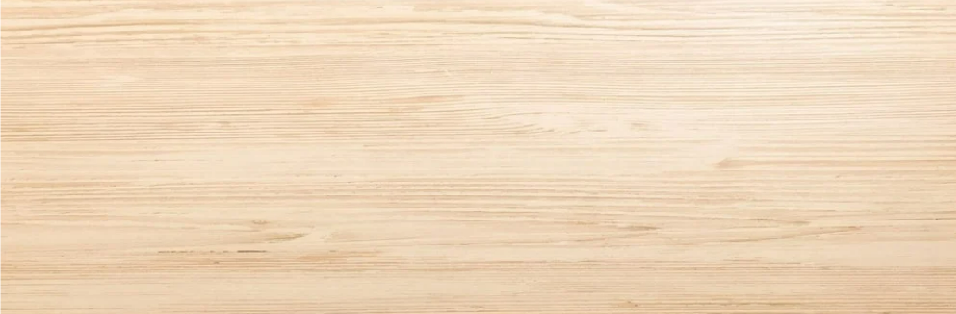
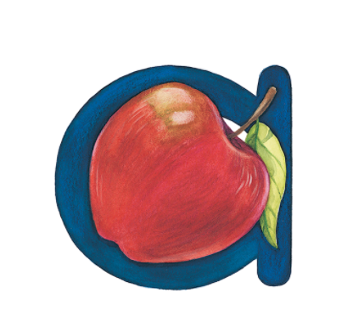

a
a

Slide 11
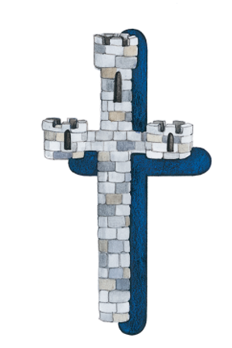
t
t

Slide 12
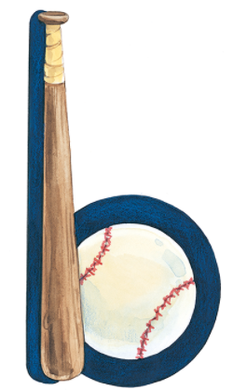
b
b

Slide 13
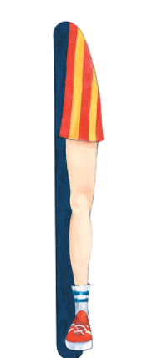
l
l

Slide 14
Blending Practice
CVC Words – From Letters Learned
In OG lesson – After audio drill
  T says phoneme, S writes letter
Practice blending letter sounds together to say word
Visual & Tactile in small group, just visual in large

Slide 15


a
t
Notes:
TEMPLATE COPY DO NOT USE

Slide 16
t
a
b
Notes:
TEMPLATE COPY DO NOT USE

Slide 17
b
a
t
Notes:
TEMPLATE COPY DO NOT USE

Slide 18
l
a
b

Slide 19
Teaching Conventions of Print
FLOSSZ Rule
In a short word with a short vowel immediately followed by f, l, s, or z, double the f, l, s, or z
Short = one syllable

Slide 20


p
u
ff

Slide 21
h
i
ll

Slide 22
t
o
ss

Slide 23
b
u
zz

Slide 24
Magic e
When ‘e’ appears at the end of a word, and only 1 consonant separates it from the vowel, ‘e’ makes the vowel say its name

Slide 25
‘e’ makes the ‘a’ say its name
g a t e
vowel
one consonant sound separates e and vowel
word ends in e

Slide 26
Vocabulary
Any time working with words, integrate…
“Do you know what this means?”
“This word means…”
Have students act out words
Discuss multiple meanings (brief!)

Slide 27
Comprehension
Any time student reads or you read, ask questions that span Bloom’s Taxonomy
Recall
Sequencing
“Beyond the Book”

Slide 28
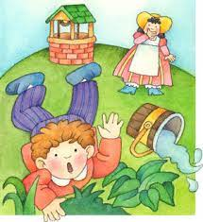
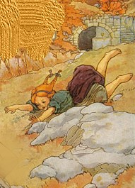
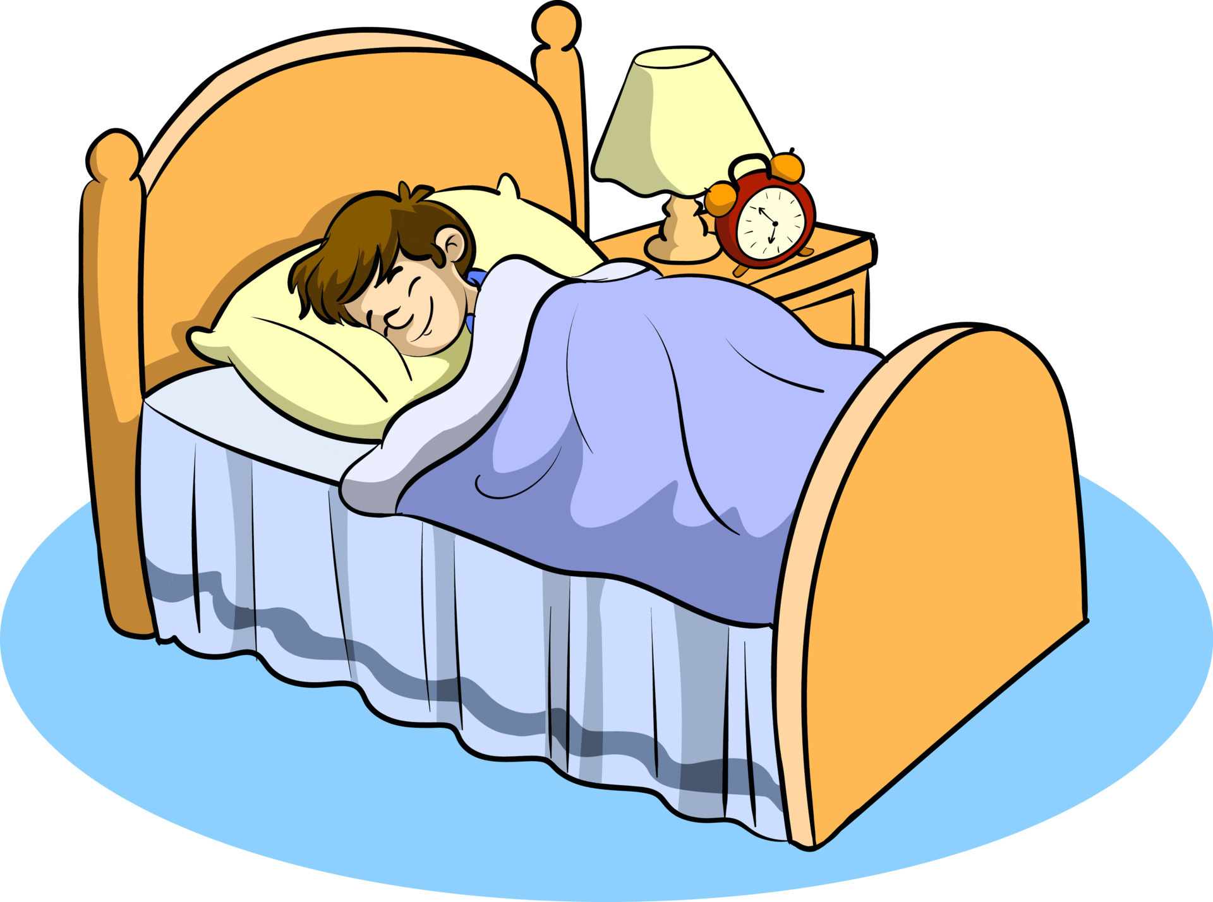
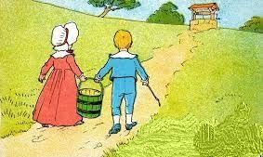
Jack and Jill
Went up the hill
To fetch a pail of water
Jack fell down and broke his crown
And Jill came tumbling after
Up Jack got
And home did trot,
As fast as he could caper;
Went to bed
To mend his head
With vinegar and brown paper.
Vocabulary
Crown, pail, fetch, tumble, caper
Beyond the Book
What do you think happened next?
Recall
Where did Jack & Jill go?
Sequencing
Put these in order of how they happened in story

Slide 29
Jack and Jill
Went up the hill
To fetch a pail of water
Jack fell down and broke his crown
And Jill came tumbling after
Up Jack got
And home did trot,
As fast as he could caper;
Went to bed
To mend his head
With vinegar and brown paper.
Vocabulary
Crown, pail, fetch, tumble, caper
Beyond the Book
What do you think happened next?
Recall
Where did Jack & Jill go?
Sequencing
Put these in order of how they happened in story

Slide 30
QUESTIONS?
Dr. Terri Hessler, Associate Professor
The Ohio State University at Newark
Lannette Gandee, Teacher
Par Excellence Academy

